Slide 1
Creative Workshop
on the topic
“Countries
and
Continents”

Slide 2
The aim of the workshop is:
to make models of the national flags of different countries

Slide 3
Flag
white
emblem
red
star
yellow
colours
elements
stripe
blue
symbol
green
black

Slide 4
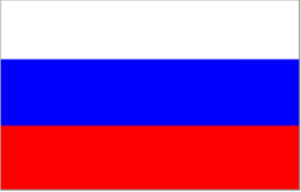
Flags of the Countries
Great Britain
Russia
India
Spain
Italy
France
Canada
China
Australia
Germany
Egypt
USA

Slide 5
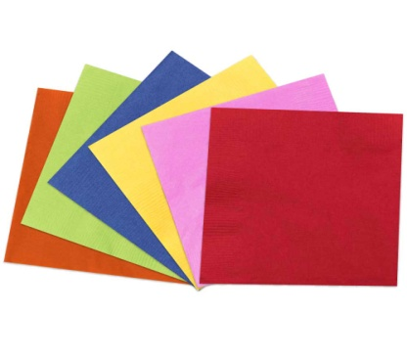
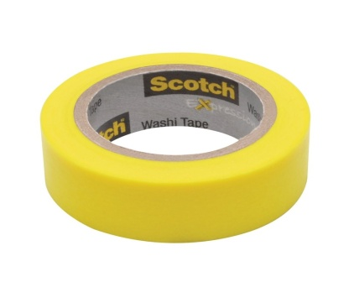
Practical Part
Materials You Need:
Colour paper
Glue
Scotch
Scissors
Pencil

Slide 6
Safety Rules
BE CAREFUL WITH SCISSORS AND GLUE!!!

Slide 7
Let’s Relax!

Slide 8
Complete the Dialogue:
What’s your name?
My name is ………..
Where are you from?
I’m from …………………
What is your nationality?
I am ……………………………..
What language do you speak?
I speak ………………………………….

Slide 9
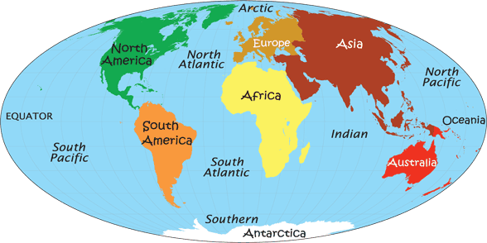
Map of the Continents

Slide 10
Complete the Statements:
It was interesting to ………………..
It was difficult to …………………….
Now I can ……………………………..
I would like to ……………………….

Slide 11
Hometask:
Make the model of the flag of North Ossetia-Alania

Slide 12
Good work! Thank you!

