Slide 1
(1) A True Friend (2) Present and Past Simple Passive (3) Past Continuous
- Androcles+the lion+a thorn in the paw
- is/are + V3/Ved was/were + V3/Ved
- was/were + Ving

Slide 2
Irregular Verbs
BE
WAS/WERE
BEEN
CAN
COULD
RUN
RAN
RUN
TAKE
TOOK
TAKEN
THINK
THOUGHT
THOUGHT
BRING
BROUGHT
BROUGHT
SEE
SAW
SEEN
CATCH
CAUGHT
CAUGHT
BECOME
BECAME
BECOME
GIVE
GAVE
GIVEN
UNDERSTAND
UNDERSTOOD
UNDERSTOOD
TELL
TOLD
TOLD
LET
LET
LET

Slide 3
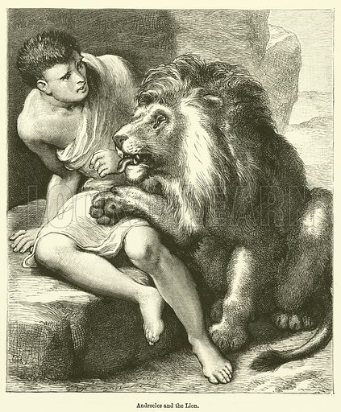
PASSIVE VOICE PRESENT SIMPLE PAST SIMPLE
SUBJECT + IS/ARE + V3/Ved
Nobody else is seen near him.
It is hidden deep in the paw.
Androcles is brought to him.
SUBJECT + WAS/WERE + V3/Ved
Nobody else was seen near him.
It was hidden deep in the paw.
Androcles was brought to him.

Slide 4
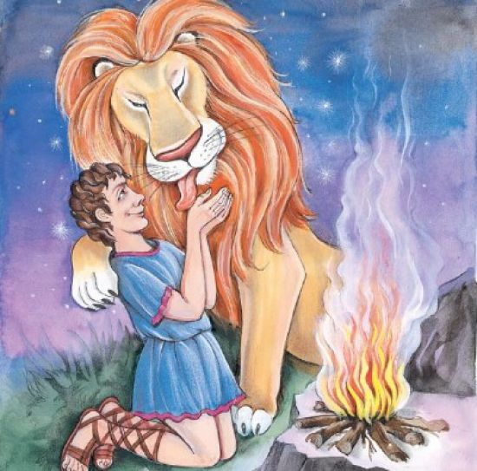
Past Simple Passive (with irregular verbs)
‘видеть’
‘понимать’
‘взять’
‘приносить’
‘поймать’
‘отдавать’
‘рассказывать’
– Androcles was seen deep in the forest.
– The Emperor was understood by the people.
– Androcles was taken to the Emperor.
– The lion was brought there too.
– Both friends were caught in the forest.
– Androcles was given to the lion.
– An interesting story was told to the Emperor by Androcles.

Slide 5
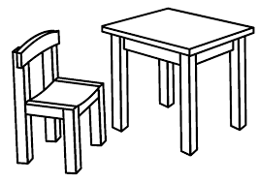
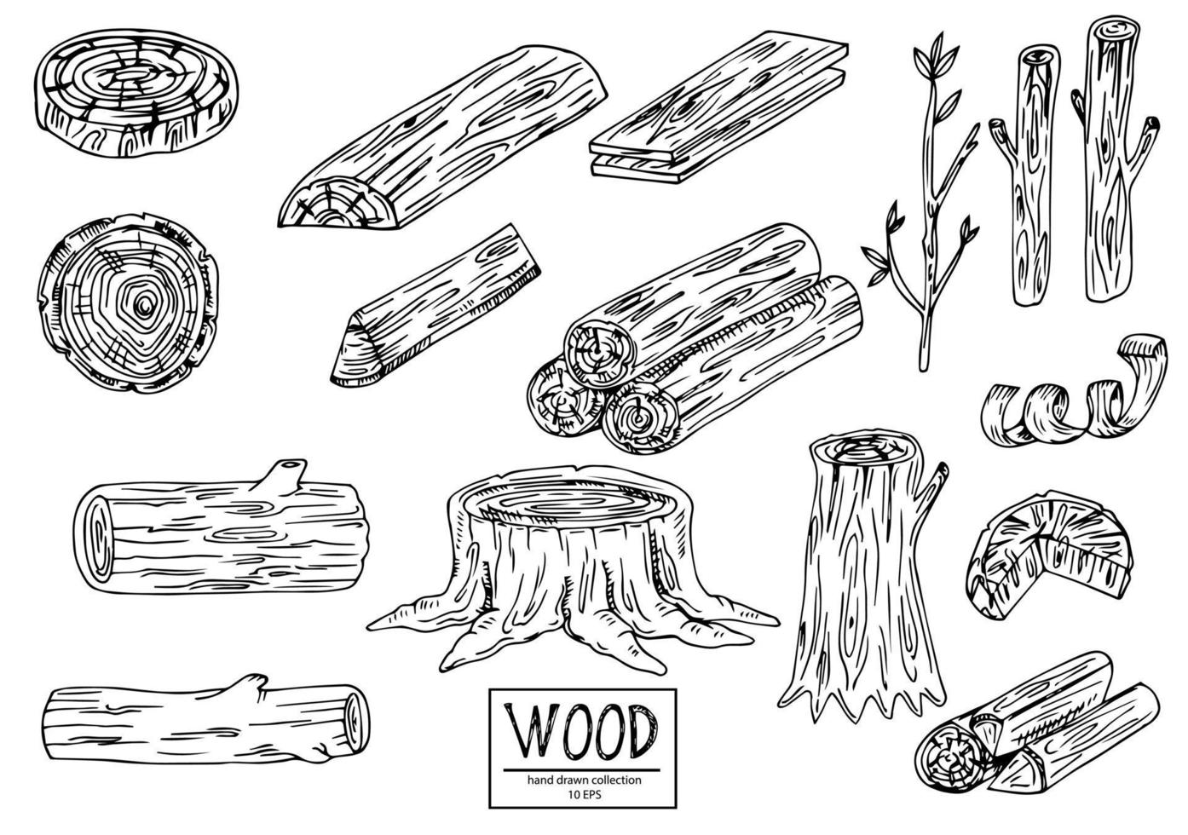
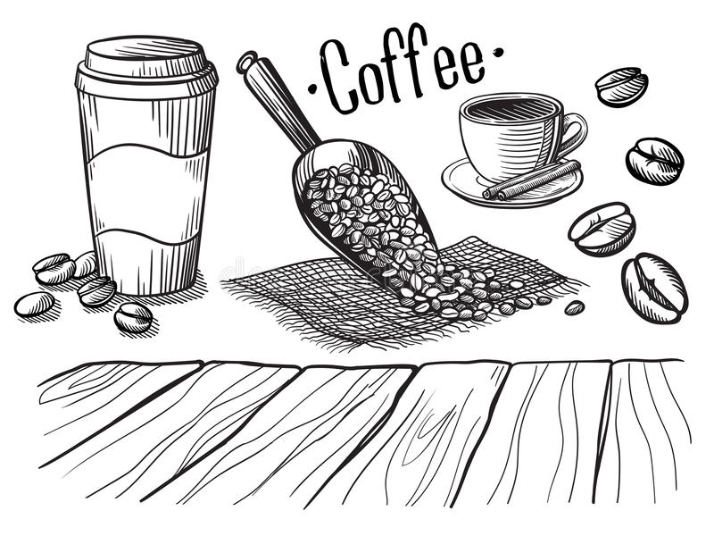
ANSWER THE QUESTIONS
основывать
FOUND-FOUNDED-FOUNDED in 1147
открывать, обнаруживать
DISCOVER-DISCOVERED-DISCOVERED in 1492
делать, изготавливать
MAKE-MADE-MADE
выращивать
GROW-GREW-GROWN
продавать
SELL-SOLD-SOLD

Slide 6
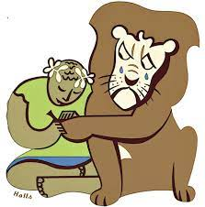
Past Continuous
was/were + Ving
when the action was in progress at a certain period of time in the past
THE LION WAS BREATHING HARD.
when the action in progress was interrupted by another short action in the past
THE LION WAS BREATHING HARD WHEN ANDROCLES SAW HIM.
when there were two simultaneous actions in progress in the past
WHILE ANDROCLES WAS TAKING THE THORN OUT OF THE LION’S PAW, THE LION WAS BREATHING HARD.

Slide 7
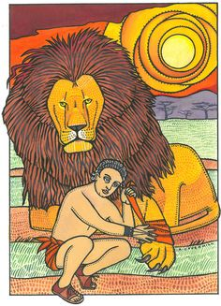
5-TYPE QUESTIONS (in Past Continuous)
THE LION WAS BREATHING HARD.
- GENERAL (YES/NO) - ?
- SUBJECT - ?
- WH - ?
- ALTERNATIVE - ?
- TAG - ?
Was the lion breathing hard?
Who was breathing hard?
Why was the lion breathing hard?
Was the lion or Androcles breathing hard?
The lion was breathing hard, wasn’t he?

Slide 8
ANDROCLES AND THE LION

